Slide 1

Samasati Nature Retreat
South Caribbean
Costa Rica

Slide 2
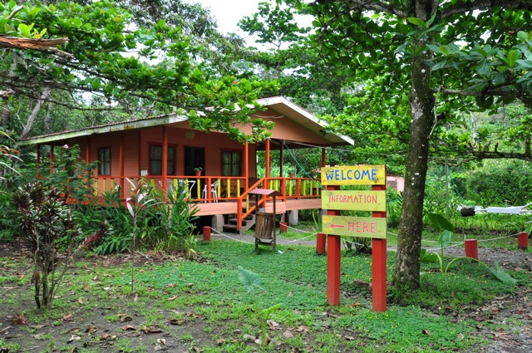
Arriving at Samasati

Slide 3
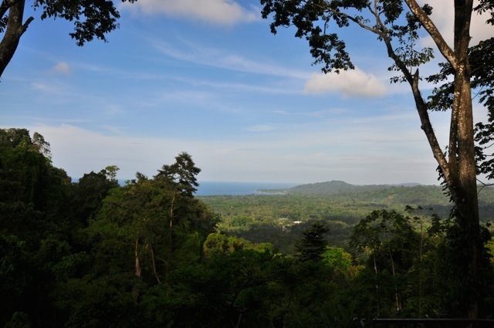
Tranquility … Inspiration … Wellness

Slide 4
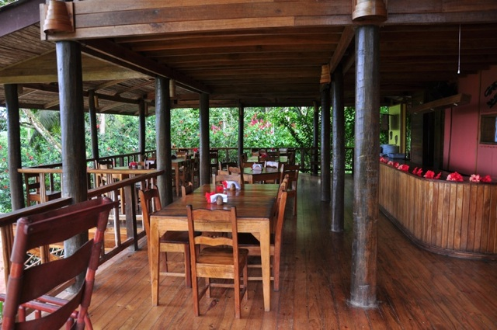
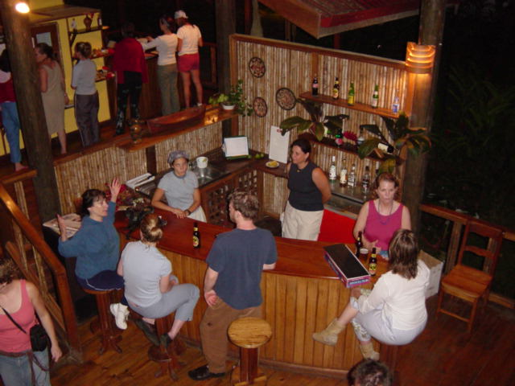
The Center of Samasati is our Restaurant, with a bar, a gift shop and a welcoming reception …

Slide 5
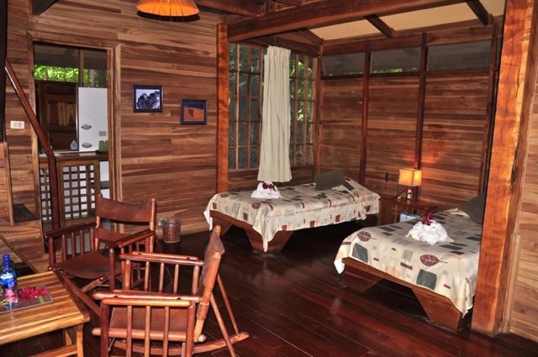
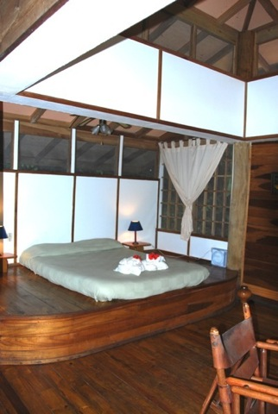
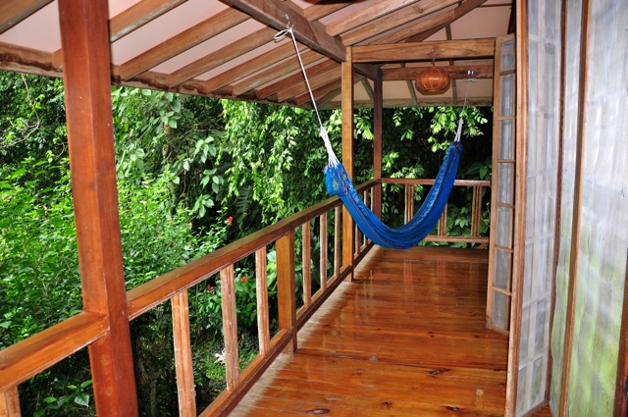
We have 10 bungalows that can accommodate 26 people in single, double or triple occupancy

Slide 6
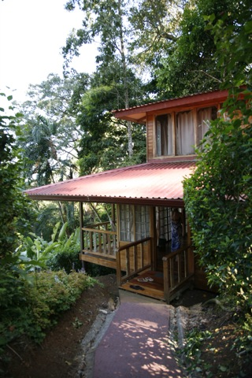
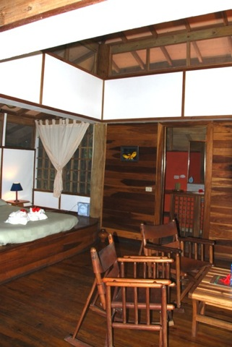
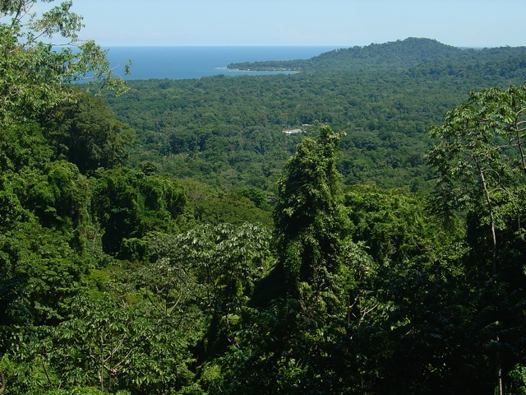
All the buildings are nestled in the forest and they have been built with wood from reforestation.
Privacy, nature and spectacular views

Slide 7
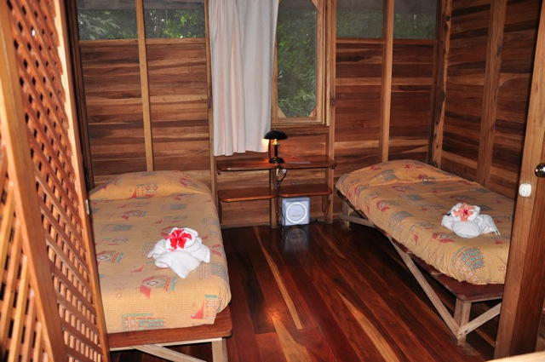
The Guest house standard has 5 double bedrooms that share two large two bathrooms. Simple yet comfortable rooms.

Slide 8
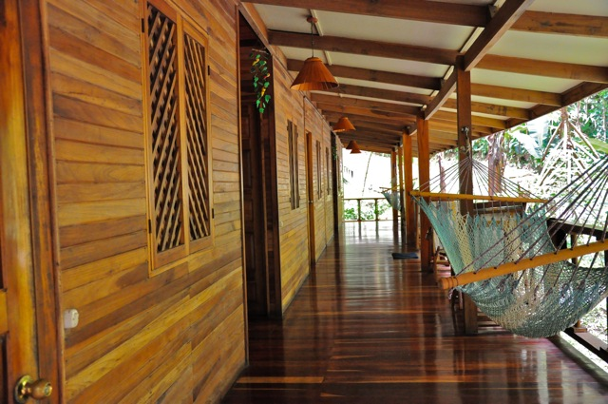
The Guest House large veranda …

Slide 9
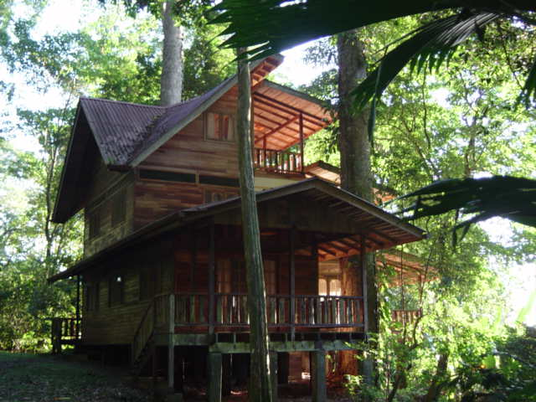
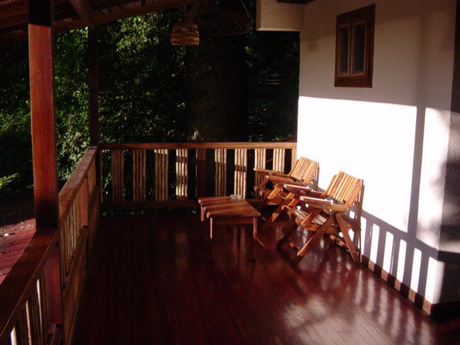
Among two beautiful big trees you find our Guest house deluxe. Three large bedrooms with queen size bed, sharing one bathroom.

Slide 10
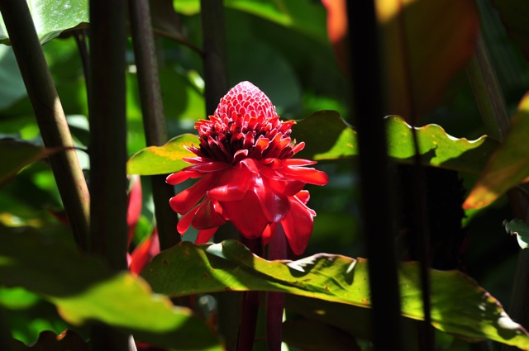
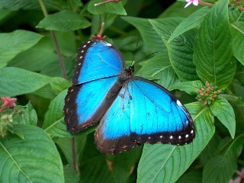
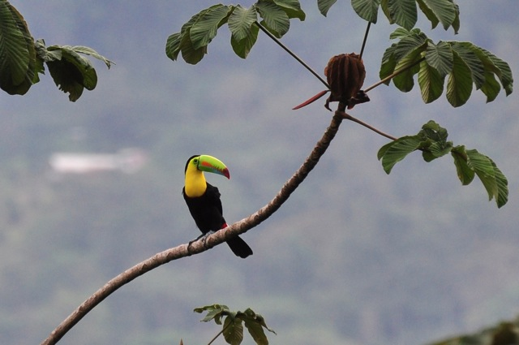
Flowers, birds, monkeys, butterflies. You can watch them all from the comfort of your room.

Slide 11
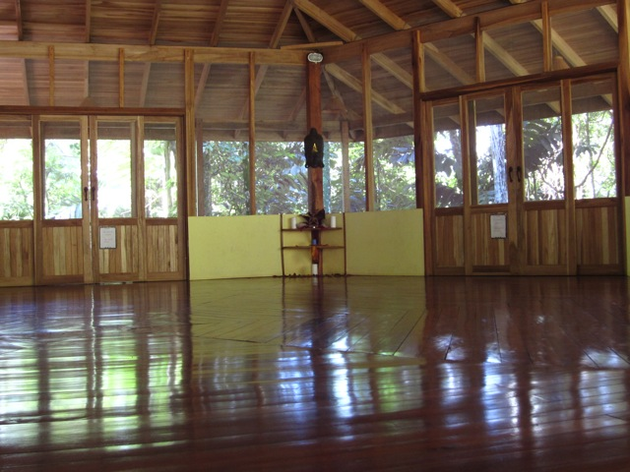
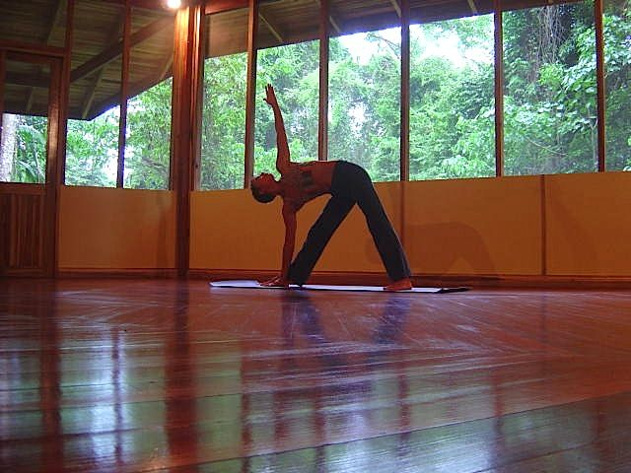
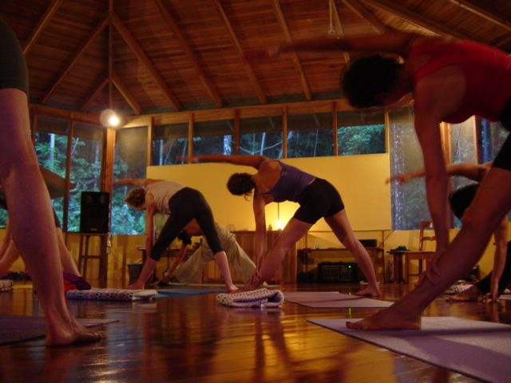
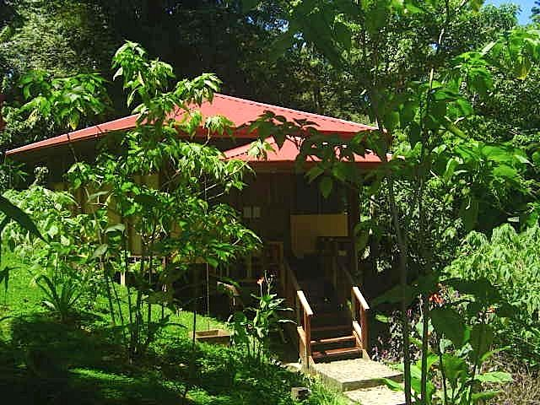
The Yoga rooms

Slide 12
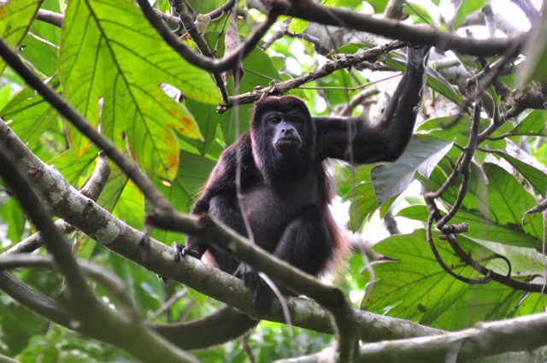
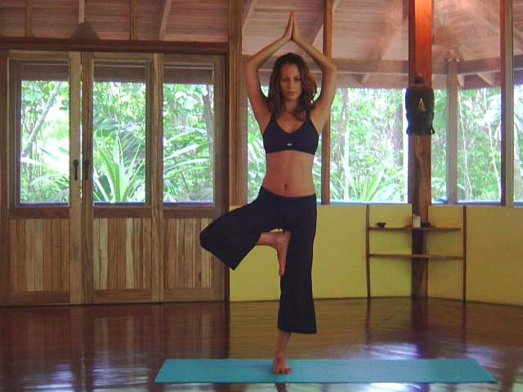
Both yoga rooms are fully equipped and 40 people can do yoga … while monkeys are the only spectators !

Slide 13
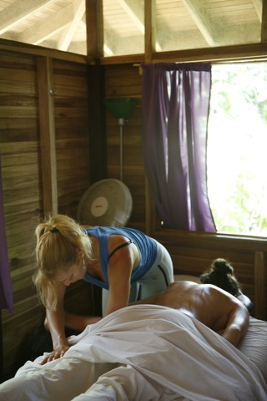
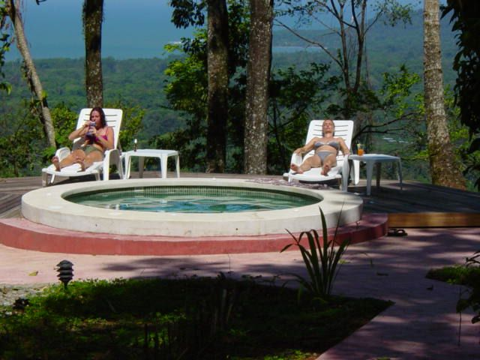
The SPA and the Hot tub … To re-energize, refresh and rejuvenate you

Slide 14
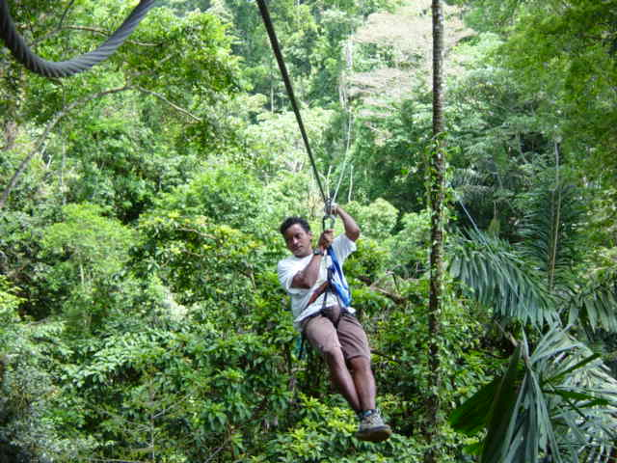
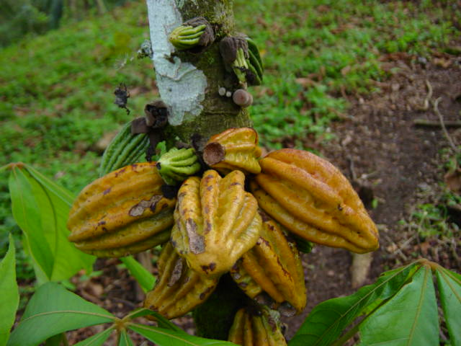
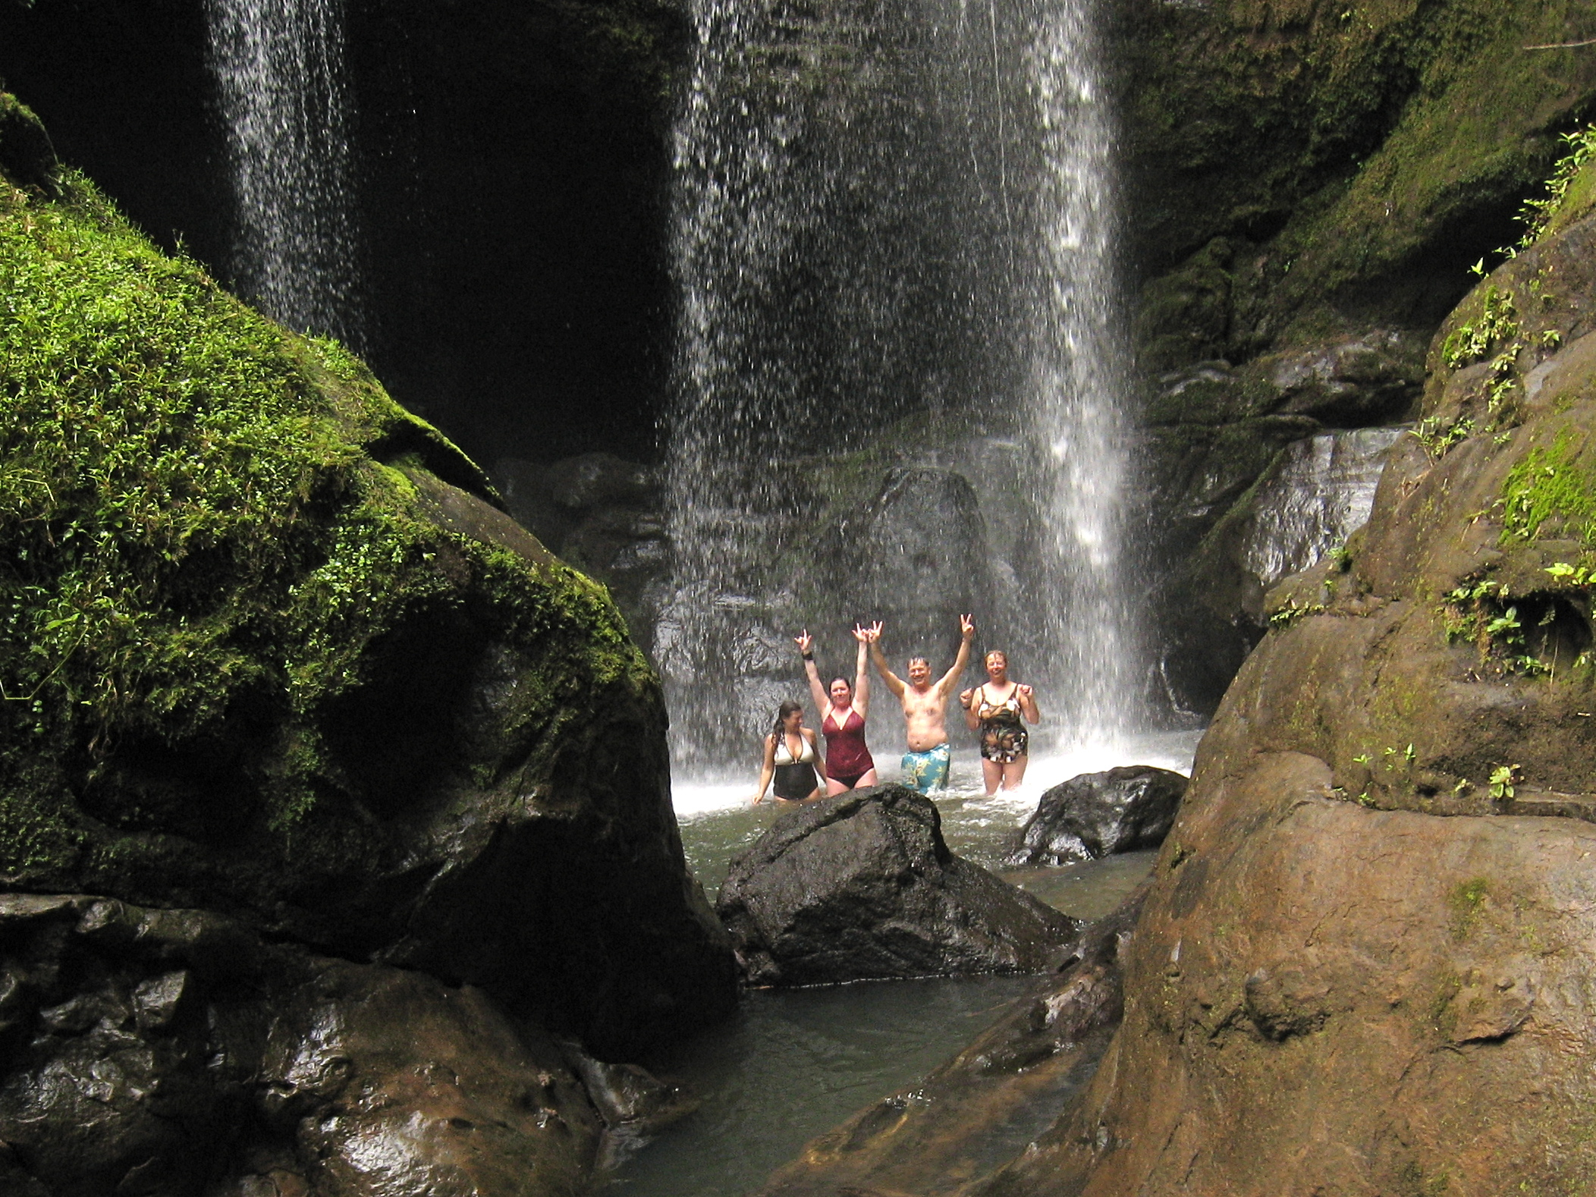
Some of the excursions we offer:
Canopy tour
Waterfall trekking
Cacao trail park tour

Slide 15
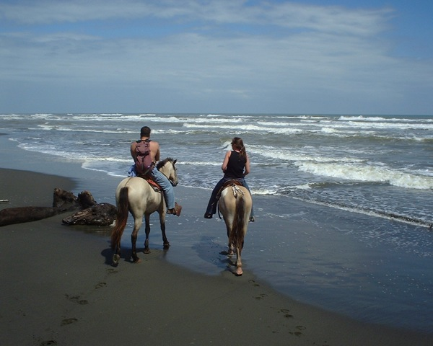
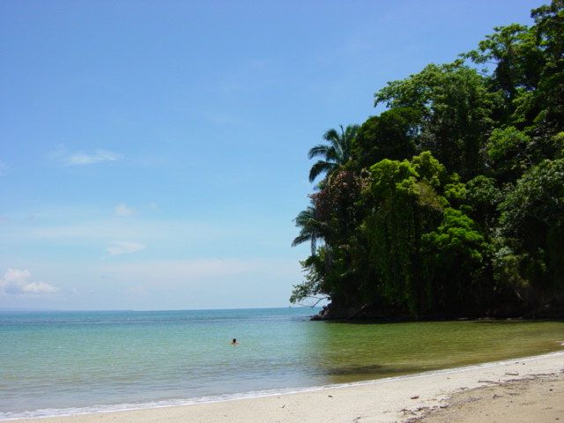
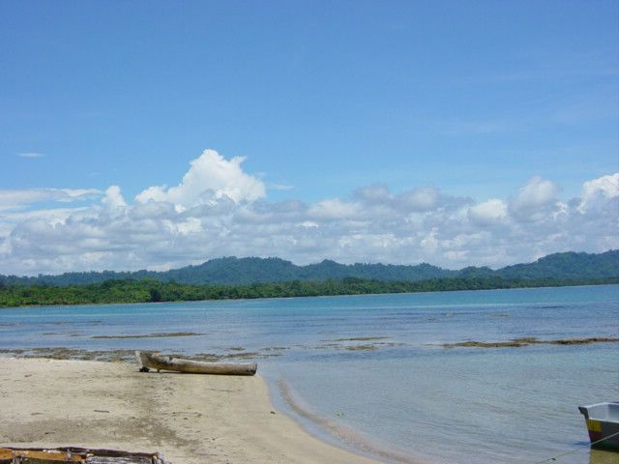
horseback riding, visit to the Cahuita national park … or simply laying on one of the beautiful beaches near by.
Your vacation will be unforgettable!

Slide 16
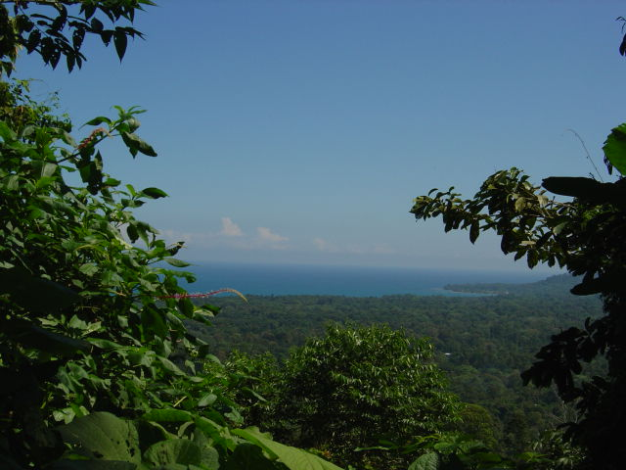
Come and visit us with your students, your clients, friends or family…
Samasati offers the best of the South Caribbean
http://www.samasati.com

